Slide 1
Natural Language Processing Specialization Sentiment Analysis with Logistic Regression
(2020 Deeplearning.ai)
YangXi’s Reading Notes

Slide 2
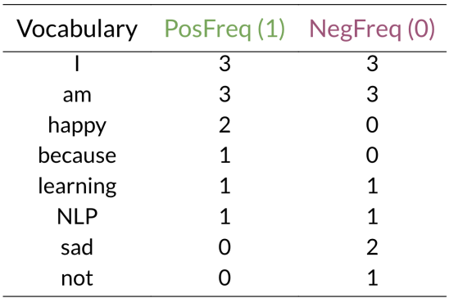
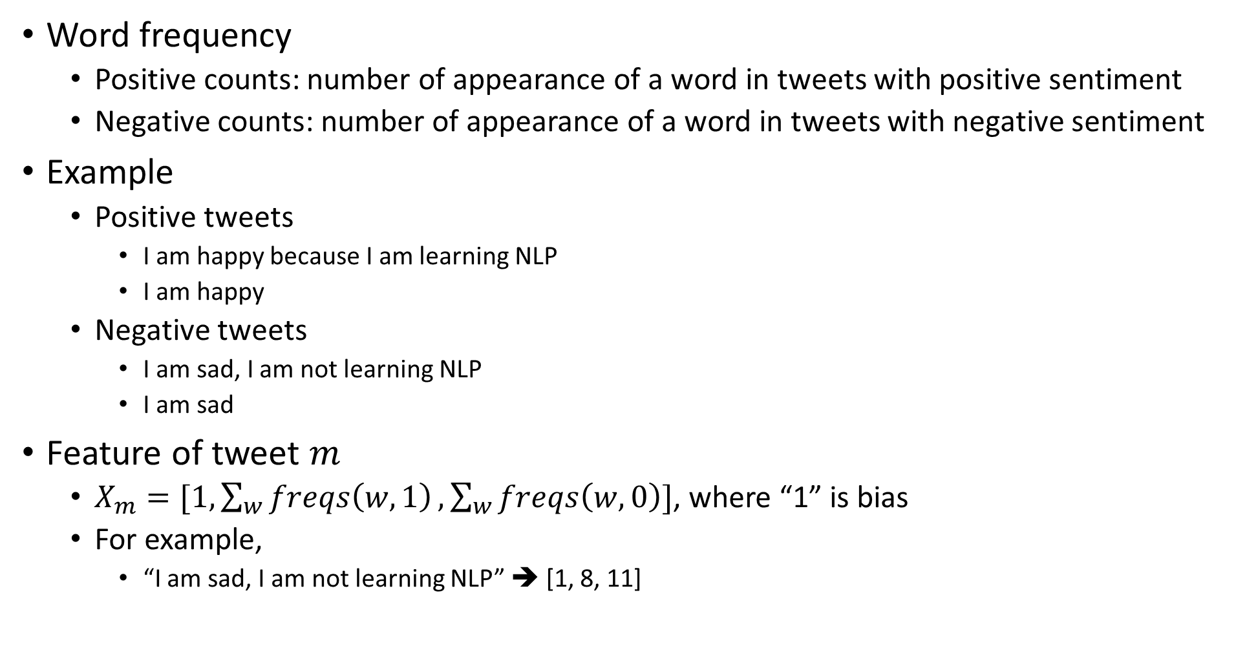


Feature Extraction with Positive and Negative Frequency
Word frequency
Positive counts: number of appearance of a word in tweets with positive sentiment
Negative counts: number of appearance of a word in tweets with negative sentiment
Example
Positive tweets
I am happy because I am learning NLP
I am happy
Negative tweets
I am sad, I am not learning NLP
I am sad
Feature of tweet $m$
$X_{m}=[1, \sum_{w}{freqs\left(w,1\right)},\sum_{w}{freqs\left(w,0\right)}]$, where “1” is bias
For example,
“I am sad, I am not learning NLP” ➔ [1, 8, 11]
$$freqs(w,1)$$
$$freqs(w,0)$$

Slide 3
Text Preprocessing
Eliminate irrelevant contents, which may include
Handles (@) and URLs
Numbers
punctuations
Convert to lower case
Tokenize string into words
Remove stop words / short words
Stemming / Lemmatization
...

Slide 4
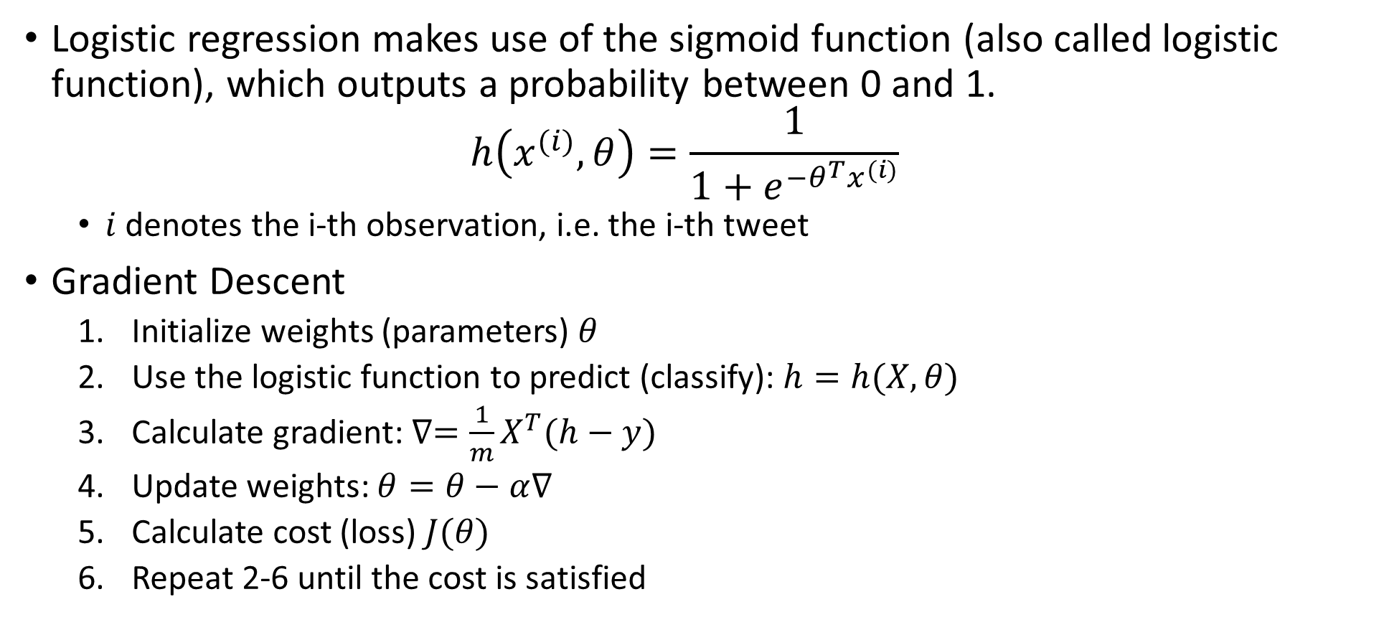
Logistic Regression: Training Gradient Descent
Logistic regression makes use of the sigmoid function (also called logistic function), which outputs a probability between 0 and 1. $h\left(x^{(i)},θ\right)=\frac{1}{1+e^{−θ^{T}x^{(i)}}}$
$i$ denotes the i-th observation, i.e. the i-th tweet
Gradient Descent
Initialize weights (parameters) $θ$
Use the logistic function to predict (classify): $h=h(X,θ)$
Calculate gradient: $∇=\frac{1}{m}X^{T}(h−y)$
Update weights: $θ=θ−α∇$
Calculate cost (loss) $J(θ)$
Repeat 2-6 until the cost is satisfied

